Slide 1

Database Security and Database Recovery

Slide 2
INDEX
DATABASE
TYPES OF DATABASES
DATABASE MANAGEMENT SYSTEM
DATA RECOVERY
  FAILURE CLASSIFICATION
  TRANSACTION FAILURE
  SYSTEM CRASH
  DISK FAILURE
  STORAGE STRUCTURE
    VOLATILE STORAGE
    NON-VOLATILE STORAGE
  RECOVERY AND ATOMICITY
  LOG BASED RECOVERY
  RECOVERY WITH CONCURRENT TRANSACTIONS
  CHECKPOINT
  HOW DATA RECOVERY WORKS
  DATA RECOVERY METHODS.
DATA SECURITY
  WHY IS DATA SECURITY IMPORTANT?
  SOURCES OF VULNERABILITY
  SECURITY THREATS: MOST COMMON ATTACKS
  DATA SECURITY ARCHITECTURE
  OBJECTIVES OF THE SECURITY ARCHITECTURE
  DATABASE SECURITY STRATEGY
  KEY PILLARS OF DATABASE SECURITY STRATEGY
  METHODS TO SECURE DATABASES
  DATABASE SECURITY BEST PRACTICES
  10 BEST SYSTEMS AVAILABLE FOR BUSINESS PROFESSIONALS.

Slide 3
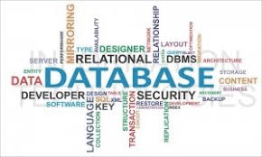
DATABASE
A database is an organized collection of data, generally stored and accessed electronically from a computer system.

Slide 4
Types Of Database
Traditional Database(TDB)
  A Traditional Database consists of texts and numbers only.
Multimedia Database(MDB)
  A Multimedia database (MMDB) is a collection of related multimedia data.
  The multimedia data include one or more primary media data types such as text, images, graphic objects (including drawings, sketches and illustrations) animation sequences, audio and video.
Geographic Information System(GIS)
  A geographic information system (GIS) is a system designed to capture, store, manipulate, analyse, manage, and present spatial or geographic data.

Slide 5
Types Of Database
Realtime Database(RDB)
  A real-time database is a database system which uses real-time processing to handle workloads whose state is constantly changing.
  This differs from traditional databases containing persistent data, mostly unaffected by time. For example, a stock market changes very rapidly and is dynamic.
Data Warehouse(DW)
  Data warehouse (DW or DWH), also known as an enterprise data warehouse (EDW), is a system used for reporting and data analysis, and is considered a core component of business intelligence.
  DWs are central repositories of integrated data from one or more disparate sources. They store current and historical data in one single place that are used for creating analytical reports for workers throughout the enterprise.

Slide 6
Database Management System(DBMS)
The software which is used to manage database is called Database Management System (DBMS). For Example, MySQL, Oracle etc. are popular commercial DBMS used in different applications. DBMS allows users the following tasks:
Data Definition: It helps in creation, modification and removal of definitions that define the organization of data in database.
Data Updation: It helps in insertion, modification and deletion of the actual data in the database.
Data Retrieval: It helps in retrieval of data from the database which can be used by applications for various purposes.
User Administration: It helps in registering and monitoring users, enforcing data security, monitoring performance, maintaining data integrity, dealing with concurrency control and recovering information corrupted by unexpected failure.

Slide 7
DATABASE RECOVERY
Data recovery is the process of restoring data that has been lost, accidentally deleted, corrupted or made inaccessible.
In enterprise IT, data recovery typically refers to the restoration of data to a desktop, laptop, server or external storage system from a backup.

Slide 8
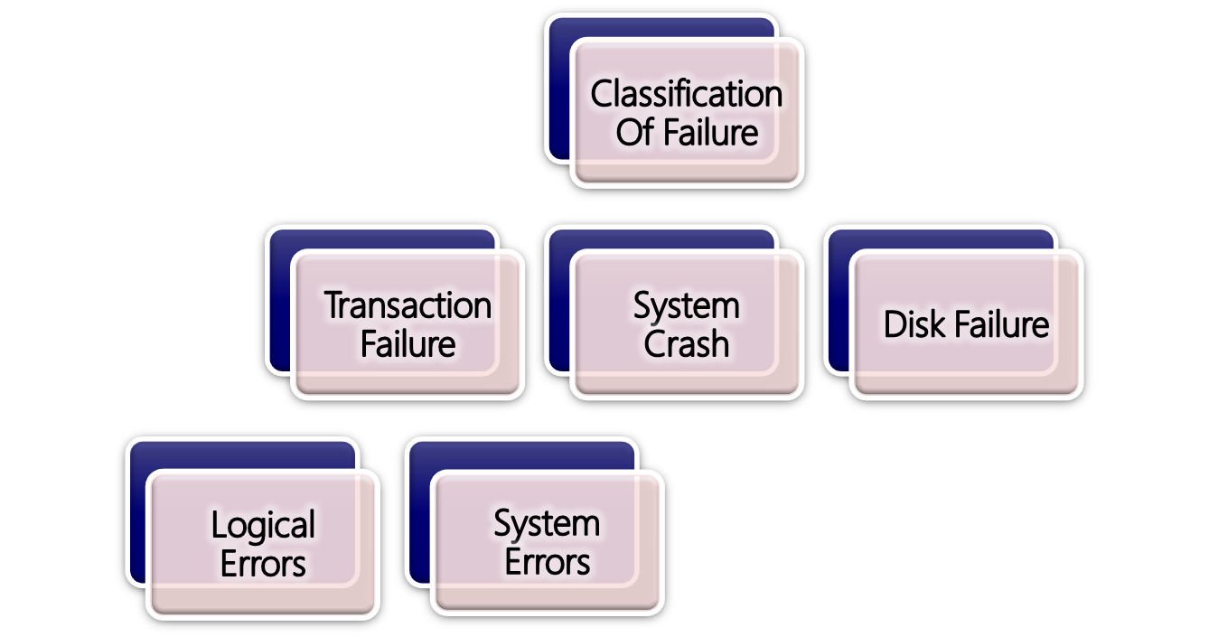
Failure Classification

Slide 9
Transaction failure
A transaction has to abort when it fails to execute or when it reaches a point from where it can’t go any further. This is called transaction failure
Reasons for a transaction failure could be −
Logical errors − Where a transaction cannot complete because it has some code error or any internal error condition.
System errors − Where the database system itself terminates an active transaction because the DBMS is not able to execute it, or it has to stop because of some system condition. For example, in case of deadlock or resource unavailability, the system aborts an active transaction.

Slide 10
System Crash
There are problems − external to the system − that may cause the system to stop abruptly and cause the system to crash.
For example, interruptions in power supply may cause the failure of underlying hardware or software failure.
Examples may include operating system errors.

Slide 11
Disk Failure
In early days of technology evolution, it was a common problem where hard-disk drives or storage drives used to fail frequently.
Disk failures include formation of bad sectors, unreachability to the disk, disk head crash or any other failure, which destroys all or a part of disk storage.

Slide 12
Storage Structure
In brief, the storage structure can be divided into two categories −
Volatile storage
Non-Volatile storage

Slide 13
Volatile storage
As the name suggests, a volatile storage cannot survive system crashes. Volatile storage devices are placed very close to the CPU; normally they are embedded onto the chipset itself.
For example, main memory and cache memory are examples of volatile storage. They are fast but can store only a small amount of information.

Slide 14
Non-Volatile storage
    These memories are made to survive system crashes. They are huge in data storage capacity, but slower in accessibility.
    Examples may include hard-disks, magnetic tapes, flash memory, and non-volatile (battery backed up) RAM.

Slide 15
Recovery and Atomicity
When a system crashes, it may have several transactions being executed and various files opened for them to modify the data items. Transactions are made of various operations, which are atomic in nature.
But according to ACID properties of DBMS, atomicity of transactions as a whole must be maintained, that is, either all the operations are executed or none.
Notes:
In database systems, atomicity is one of the ACID (Atomicity, Consistency, Isolation, Durability) property. A transfer being atomic in database operation means that either all occur or nothing occur.
An example of an atomic transaction is a monetary transfer from bank account A to account B. It consists of two operations, withdrawing the money from account A and saving it to account B. Performing these operations in an atomic transaction ensures that the database remains in a consistent state, that is, money is neither lost nor created if either of those two operations fail.

Slide 16
Log-based Recovery
Log is a sequence of records, which maintains the records of actions performed by a transaction. It is important that the logs are written prior to the actual modification and stored on a stable storage media, which is failsafe.
The database can be modified using two approaches −
Deferred database modification − All logs are written on to the stable storage and the database is updated when a transaction commits.
Immediate database modification − Each log follows an actual database modification. That is, the database is modified immediately after every operation

Slide 17
Log-based recovery works as follows −
The log file is kept on a stable storage media.
When a transaction enters the system and starts execution, it writes a log about it.
    <Tn, Start>
When the transaction modifies an item X, it write logs as follows −
  <Tn, X, V1, V2>
It reads Tn has changed the value of X, from V1 to V2.
When the transaction finishes, it logs −
  <Tn, commit>

Slide 18
Recovery with Concurrent Transactions
When more than one transaction are being executed in parallel, the logs are interleaved. At the time of recovery, it would become hard for the recovery system to backtrack all logs, and then start recovering. To ease this situation, most modern DBMS use the concept of 'checkpoints’.

Slide 19
CHECKPOINT
Checkpoint is a mechanism where all the previous logs are removed from the system and stored permanently in a storage disk.
Checkpoint declares a point before which the DBMS was in consistent state, and all the transactions were committed.

Slide 20
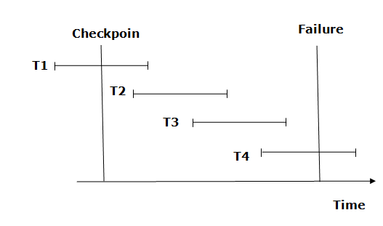
CHECKPOINT
T1, T2 and T3 transaction into redo list.
T4 will be put into undo list .
Notes:
Recovery system maintains two lists, a redo-list, and an undo-list.
2) The transaction is put into redo state if the recovery system sees a log with <Tn, Start> and <Tn, Commit> or just <Tn, Commit>. In the redo-list and their previous list, all the transactions are removed and then redone before saving their logs.
3) For example: In the log file, transaction T2 and T3 will have <Tn, Start> and <Tn, Commit>. The T1 transaction will have only <Tn, commit> in the log file. That's why the transaction is committed after the checkpoint is crossed. Hence it puts T1, T2 and T3 transaction into redo list.
4) The transaction is put into undo state if the recovery system sees a log with <Tn, Start> but no commit or abort log found.
5) In the undo-list, all the transactions are undone, and their logs are removed.
6) For example: Transaction T4 will have <Tn, Start>. So T4 will be put into undo list since this transaction is not yet complete and failed amid.

Slide 21
How data recovery works
The data recovery process varies, depending on the circumstances of the data loss, the data recovery software used to create the backup and the backup target media
Data recovery is possible because a file and the information about that file are stored in different places.

Slide 22
Data recovery methods
Standard Data Recovery is where we recover data using standard lab facilities. This is used typically for recovering data from media in case of no physical failure.
Remote Data Recovery is where we perform secure remote data recovery services. This is used in cases where the media would experience logical failures.
Notes:
Data Recovery Methods
Standard Data Recovery is where we recover data using standard lab facilities. This is used typically for recovering data from media in case of no physical failure.
Remote Data Recovery is where we perform secure remote data recovery services. This is used in cases where the media would experience logical failures.

Slide 23
Database Security
Database security refers to the collective measures used to protect and secure a database or database management software from illegitimate use and malicious threats and attacks.
Database security protects the confidentiality, integrity and availability(CIA) of an organizations.
Confidentiality is a set of rules that limits access to information.
Integrity is the assurance that the information is trustworthy and accurate.
Availability is a guarantee of reliable access to the information by authorized people.

Slide 24
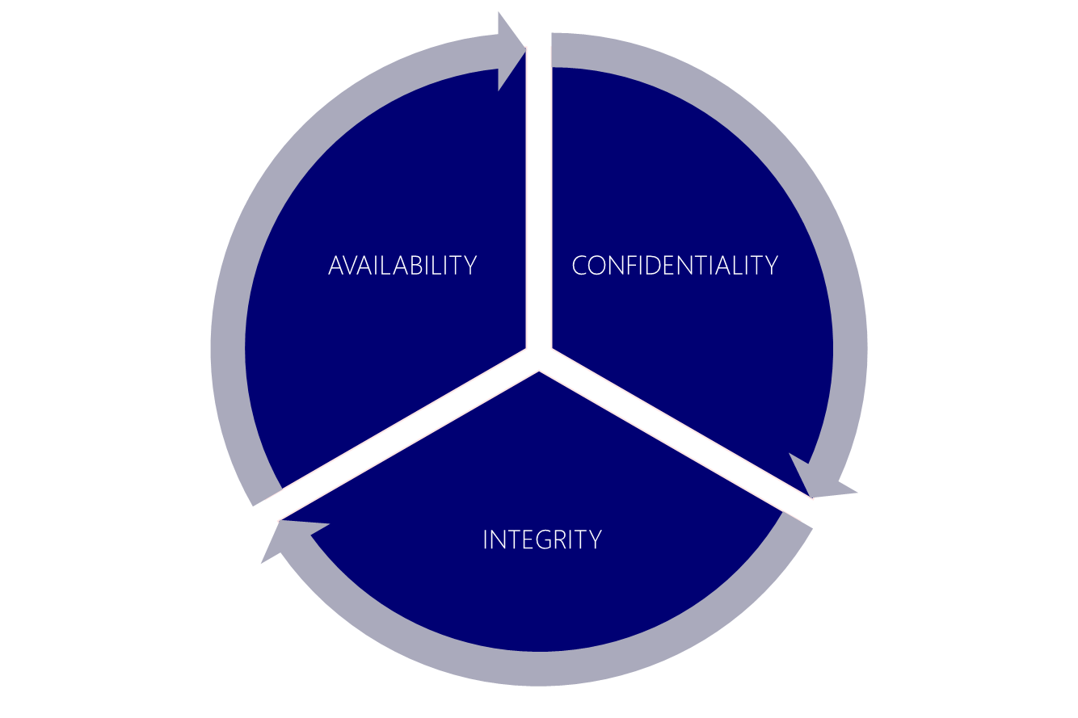
Database Security

Slide 25
Why is database security important?
Finances and reputation.
Company’s block attacks, including ransomware and breached firewalls, which in turn keeps sensitive information safe.
Prevent malware or viral infections which can corrupt data, bring down a network, and spread to all end point devices.
Ensure that physical damage to the server doesn’t result in the loss of data.
Prevent data loss through corruption of files or programming errors.
Note: In 2015 ,With an estimated world population of 7.4 billion,7% of world population was exposed to hackers and 500 million identities were exposed.

Slide 26
Sources of Vulnerability
Application:
  SQL injection attack
  Application bypass
Test and Dev:
  Access to production data in non- secure environment
  Access to production systems for trouble shooting
Administrative Account Misuse:
  System and Application admins, DBA
  Stolen credential, Inadequate Training, Malicious Insiders
Operations:
  Lost/Stolen Backups
  Direct OS Access.

Slide 27
SECURITY THREATS:MOST COMMON ATTACKS
Privilege abuse: When database users are provided with privileges that exceeds their day-to-day job requirement, these privileges may be abused intentionally or unintentionally.
Operating System vulnerabilities: Vulnerabilities in underlying operating systems like Windows, UNIX, Linux, etc., and the services that are related to the databases could lead to unauthorized access. This may lead to a Denial of Service (DoS) attack.

Slide 28
3. Database rootkits: A database rootkit is a program that is hidden inside the database and that provides administrator-level privileges to gain access to the data and may even turn off alerts triggered by Intrusion Prevention Systems (IPS).
4. Weak authentication: Weak authentication models allow attackers to employ strategies such as social engineering and brute force to obtain database login credentials and assume the identity of legitimate database users.
5. Weak audit trails: A weak audit logging mechanism in a database server represents a critical risk to an organization especially in retail, financial, healthcare, and other industries with stringent regulatory compliance . Audit trails act as the last line of database defense. Audit trails can detect the existence of a violation.

Slide 29

Data Security Architecture
Security Architecture is the design artifacts that describe how the security controls (= security countermeasures) are positioned and related to the overall systems architecture and serve the purpose to maintain the system's quality attributes.
An information security architecture is designed to be strategic to have a longer life than a blueprint, design requirement, or a topological chart or configuration. It is meant to assist in making choices associated to the identification, acquisition, design, application, implementation, deployment, and operation of elements in the organization’s technical environment.
The information security architecture should support many communities, departments, and lines of business, and should represent the long-term view of technical direction.

Slide 30
An architecture that supports:
An effective security program that recognizes that all information is not identical or continuous in terms of value and risk over time.
A well organized and efficient security program that applies the right technology to protect the utmost critical assets joint with quality processes that reduce the risks.
A high-quality security program that includes regular management reviews and technology assessments to ensure controls.

Slide 31
OBJECTIVES OF THE SECURITY ARCHITECTURE
The specific objectives and deliverables of the organization’s information security architecture can be defined as follows:
Provides guidance to the organization’s IT corporate and department decision-makers.
Supports, enables, and extends the organization’s security policy and standards by providing specific security-related guidance.
Describes general security strategies within the organization’s information security architecture domain.
Describes the high-level design objectives.
Describes the concept of “security zones ”.
Describes a risk management architecture.
Leverages leading industry standards and representations to ensure best security practices are being applied.

Slide 32
DATABASE SECURITY STRATEGY
A database security strategy focuses on proactively protecting data from internal and external attacks, curtailing data exposure to privileged and authorized IT users, and safeguarding all databases, including production and non-production.
With internal and external attacks on corporate and public applications and robust regulatory compliance enforcements, data security continues to be the highest priority for enterprises and governments year after year. at the very core, i.e;
“The databases that contain the corporate crown jewels”.

Slide 33
KEY PILLARS OF DATABASE SECURITY STRATEGY
FOUNDATION PILLAR
The “foundation pillar” stresses discovery and classification of sensitive data and devising a vigorous authentication, authorization, and access control framework. In addition, all critical databases must be patched periodically to remove known vulnerabilities.
  To establish a strong database security foundation, enterprises should use:
  Database discovery and classification, which provides information on all databases to focus upon
  AAA mechanisms for appropriate database access
  Patch management protecting against identified vulnerabilities.

Slide 34
DETECTION PILLAR
This section encompasses monitoring, auditing, and vulnerability assessment. Vulnerability assessment reports gaps in the database environment, such as weak passwords or excessive access privileges.
Data and metadata within databases can be accessed, modified, or even deleted in moments. The detection pillar emphasizes a comprehensive audit trail of database activities
Detection layer security fundamentally includes:
  Continuous auditing and alerting on data anomalies and access by privileged users
  Security monitoring and real-time intrusion prevention to defend the database against potential threats
  Vulnerability assessment to check for database integrity and security configuration across databases.

Slide 35
PREVENTIVE PILLAR
This category encompasses data encryption, data masking, and database firewall. This pillar emphases preventing unauthorized access and protecting against potential attacks.
Preventive security measures include:
  Network and data-at-rest encryption
  Data masking (redaction) across all databases to prevent data exposure.
  Database firewalls to prevent potential threats, such as SQL injection attacks or privilege escalation from impacting databases.
  Change management to enable a formal procedure to manage changes in production. The goal is to prevent unauthorized access to and exposure of private data.

Slide 36
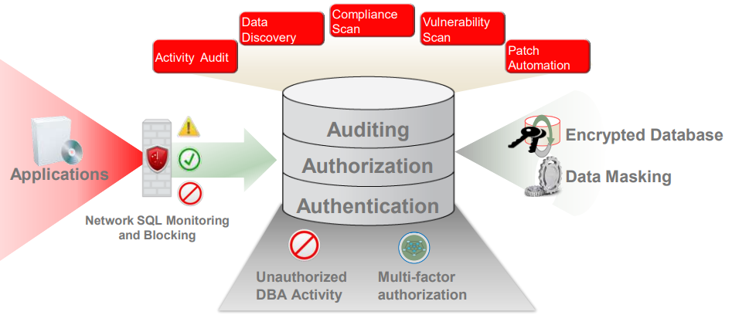
METHODS TO SECURE DATABASES
Some attackers still focus on denial of service attacks and vandalism, cybercriminals often target the database because that is where the money is.
Database security on its own is an extremely in-depth topic that could never be covered in whole. However there are a few best practices that can help even the smallest of businesses secure their databases.

Slide 37
DATABASE SECURITY BEST PRACTICES
Separate the Database and Web Servers
  Always keep the database server separate from the web server. Most vendors try to make things easier by having the database created on the same server that the application is installed.
  This also makes it easier for an attacker to access the data because they only need to crack the administrator account for one server to have access to everything.
  Instead, a database should reside on a separate database server located behind a firewall, not in the DMZ with the web server. This makes for a more complicated setup.

Slide 38
Encrypt stored files
  The stored files of a web application often contain information about the databases that the software needs to connect to. This information, if stored in plain text like many default installations do, provide the keys an attacker needs to access sensitive data.
  WhiteHat security estimates that 83 percent of all web sites are vulnerable to at least one form of attack. The stored files of a web application often contains information about the databases the software needs to connect to. This information, if stored in plain text like many default installations do, provide the keys an attacker needs to access sensitive.
Encrypt Your Backups Too
  Encrypt back-up files. Not all data theft happens as a result of an outside attack. Sometimes, it’s the people we trust most that are the attackers.

Slide 39
Use WEB APPLICATION FIREWALL (WAF)
  Many people are under the misconception that protecting the web server has nothing to do with the database. This is not true. In addition to protecting a site against cross-site scripting vulnerabilities and website vandalism, a good application firewall can thwart SQL injection attacks as well. By preventing the injection of SQL queries by an attacker, the firewall can help keep sensitive information stored in the database away from attackers.
  Websites that utilize third-party applications, components, and various other plug-ins and add-ons are more susceptible to an exploit than those that have been patched.

Slide 40
Minimize Use of 3rd Party Apps
  Keep third-party applications to a minimum. We all want our web site to be filled with interactive widgets and sidebars filled with cool content, but any app that pulls from the database is a potential threat. Many of these applications are created by hobbyists or programmers who discontinue support for them. Unless they are absolutely necessary, don’t install them.
Don't Use a Shared Server
  Avoid using a shared web server if your database holds sensitive information. While it may be easier, and cheaper, to host your site with a hosting provider you are essentially placing the security of your information in the hands of someone else. If you have no other choice, make sure to review their security policies and speak with them about what their responsibilities are should your data become compromised.

Slide 41
Enable Security Controls
  Enable security controls on your database. While most databases nowadays will enable security controls by default, it never hurts for you to go through and make sure you check the security controls to see if this was done.
  Keep in mind that securing your database means you have to shift your focus from web developer to database administrator. In small businesses, this may mean added responsibilities and additional buy in from management. However, getting everyone on the same page when it comes to security can make a difference between preventing an attack and responding to an attack.

Slide 42
10 OF THE BEST SYSTEMS AVAILABLE FOR BUSINESS PROFESSIONALS:
Oracle
Microsoft SQL Server
MySQL
PostgreSQL
Microsoft Access
Teradata
IBM DB2
Informix
SAP ASE(Sybase Adaptive Server Enterprise)
Amazon’s SimpleDB

Slide 43
Disk Storage, Basic File structures And Hashing

Slide 44
CONTENTS
Introduction
Secondary Storage Devices
Buffering of Blocks
Placing File Records on Disk
Operations on Files
Files of Unordered Records (Heap Files)
Files of Ordered Records (Sorted Files)
Hashing Techniques
Parallelizing Disk Access Using RAID Technology

Slide 45
INTRODUCTION
In a computerized database, the data is stored on computer storage medium, which includes:
Primary Storage: can be processed directly by the CPU (e.g., the main memory, cache) –fast, expensive, but of limited capacity
Secondary Storage: cannot be processed directly by the CPU (e.g., magnetic disks, optical disks, tapes) –slow, cost less, but have a large capacity.

Slide 46
For the following reasons, most databases must are stored permanently on secondary storage:
They are too large to fit entirely in main memory
They must persist over long period of times, but the main memory is a volatile storage
Secondary storage costs less
Note: In Real-time applications, such as telephone switching applications, entire database can be kept in the main memory (with a backup copy on secondary devices) – main memory databases.

Slide 47
SECONDARY STORAGE DEVICES
Magnetic tapes (offline): operator must load it
Magnetic Disks (online): can be accessed directly
The capacity of a device is the number of bytes it can store
A disk can be single-sided or double-sided
Many disks are assembled into a disk pack

Slide 48
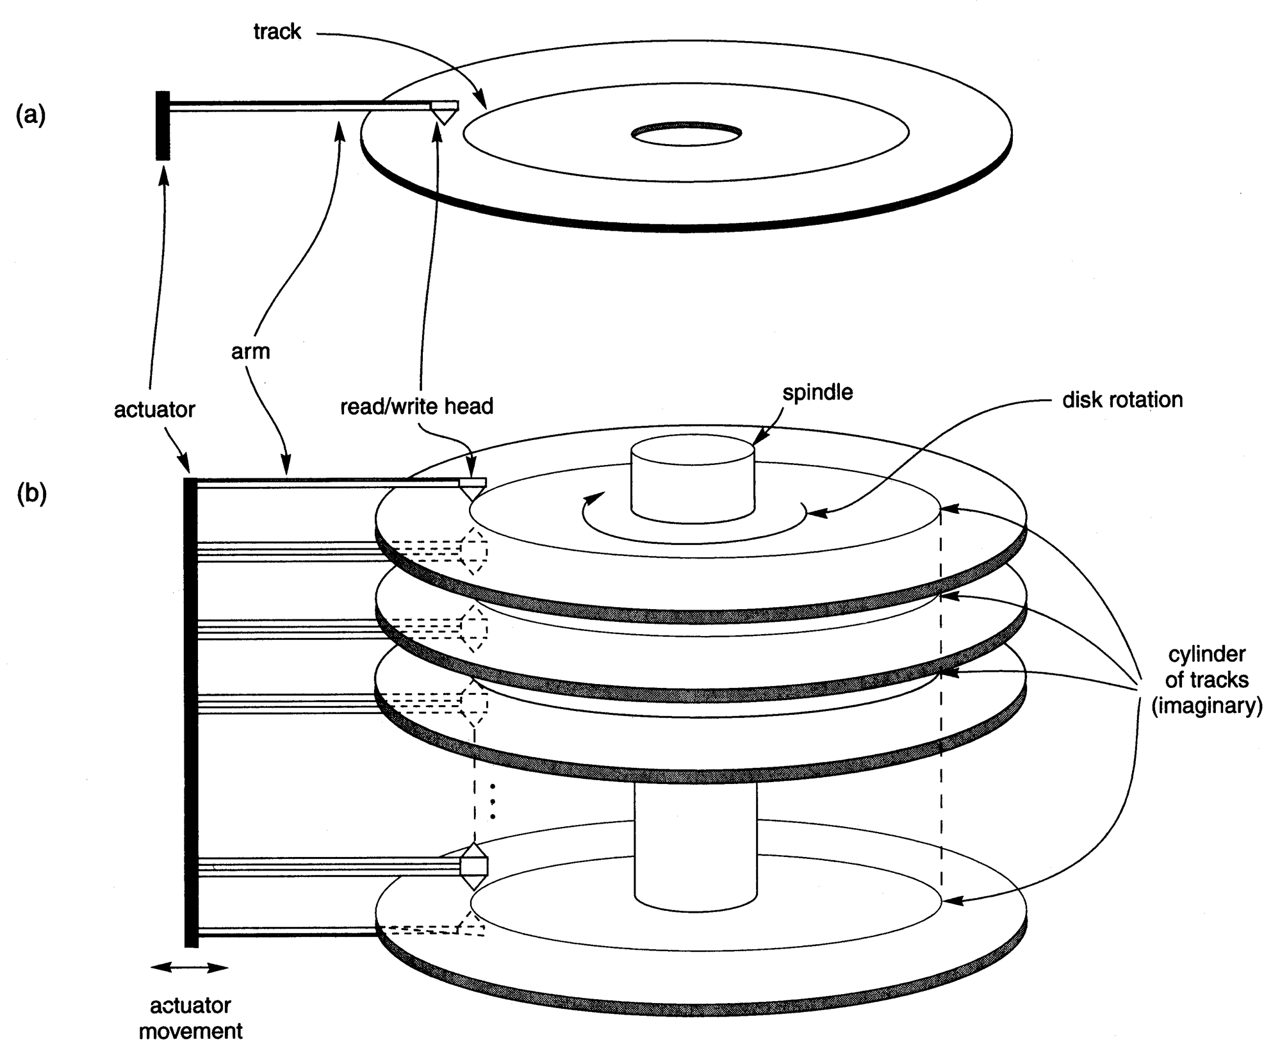
SECONDARY STORAGE DEVICES
A
single-sided
disk with
read/write
hardware
(b) A disk
pack with
read/write
hardware

Slide 49
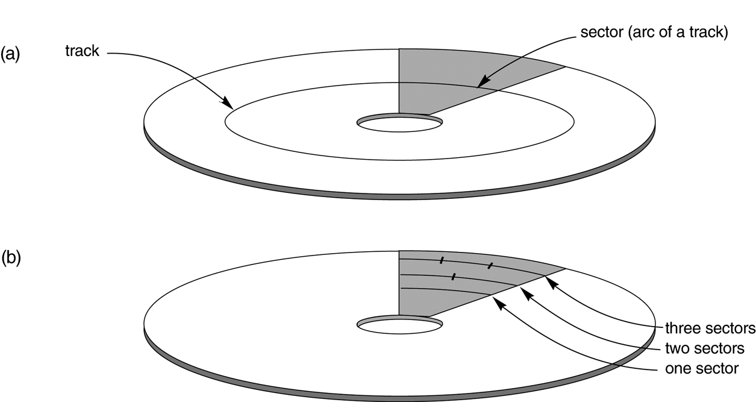
SECONDARY STORAGE DEVICES
Different sector organizations on disk:
Sectors subtending a fixed angle
Sectors maintaining a uniform recording density

Slide 50
SECONDARY STORAGE DEVICES
The tracks with the same diameter on the various surfaces are called a cylinder
During disk formatting (initializing), each track is divided into equal-sized disk blocks (or pages)
Blocks are separated by fixed-size interblock gaps
A disk is a random access addressable device
A combination of a cylinder number, track number, and block number is supplied the hardware address of a block.

Slide 51
SECONDARY STORAGE DEVICES
A buffer is a contiguous reserved area in main memory that holds one block.
For a read command, the block from disk is copied into the buffer.
For a write command, the contents of the buffer are copied into the disk.
The read/write head is the hardware mechanism that reads or writes a block.

Slide 52
SECONDARY STORAGE DEVICES
A disk pack is mounted in the disk drive, which includes a motor that rotates the disks.
A disk controller controls the disk drive and interfaces it to the computer system.
The time required that the disk controller mechanically positions the read/write head on the correct track is called the seek time.
The time required that the beginning of the desired block rotates into position under the read/write head is called the rotational delay or latency.

Slide 53
SECONDARY STORAGE DEVICES
After finding the desired block, the time required to transfer the data (read or write a block) is called the block transfer time.
The seek time and rotational delay are usually much larger than the block transfer time.
The time required to transfer consecutive blocks is usually determined by the bulk transfer rate.
A magnetic tape is a sequential access device.
A tape drive includes a mechanism to read the data from or to write the data to a tape reel.

Slide 54
BUFFERING OF BLOCKS
Buffers are reserved in main memory to speed up the processes.
While one buffer is being read or written (by disk controllers), the CPU can process data in the other buffers.
Buffers play an important role when processes are running concurrently, either in an interleaved or parallel fashion.
Double buffering enables continuous reading or writing of data on consecutive disk blocks.

Slide 55
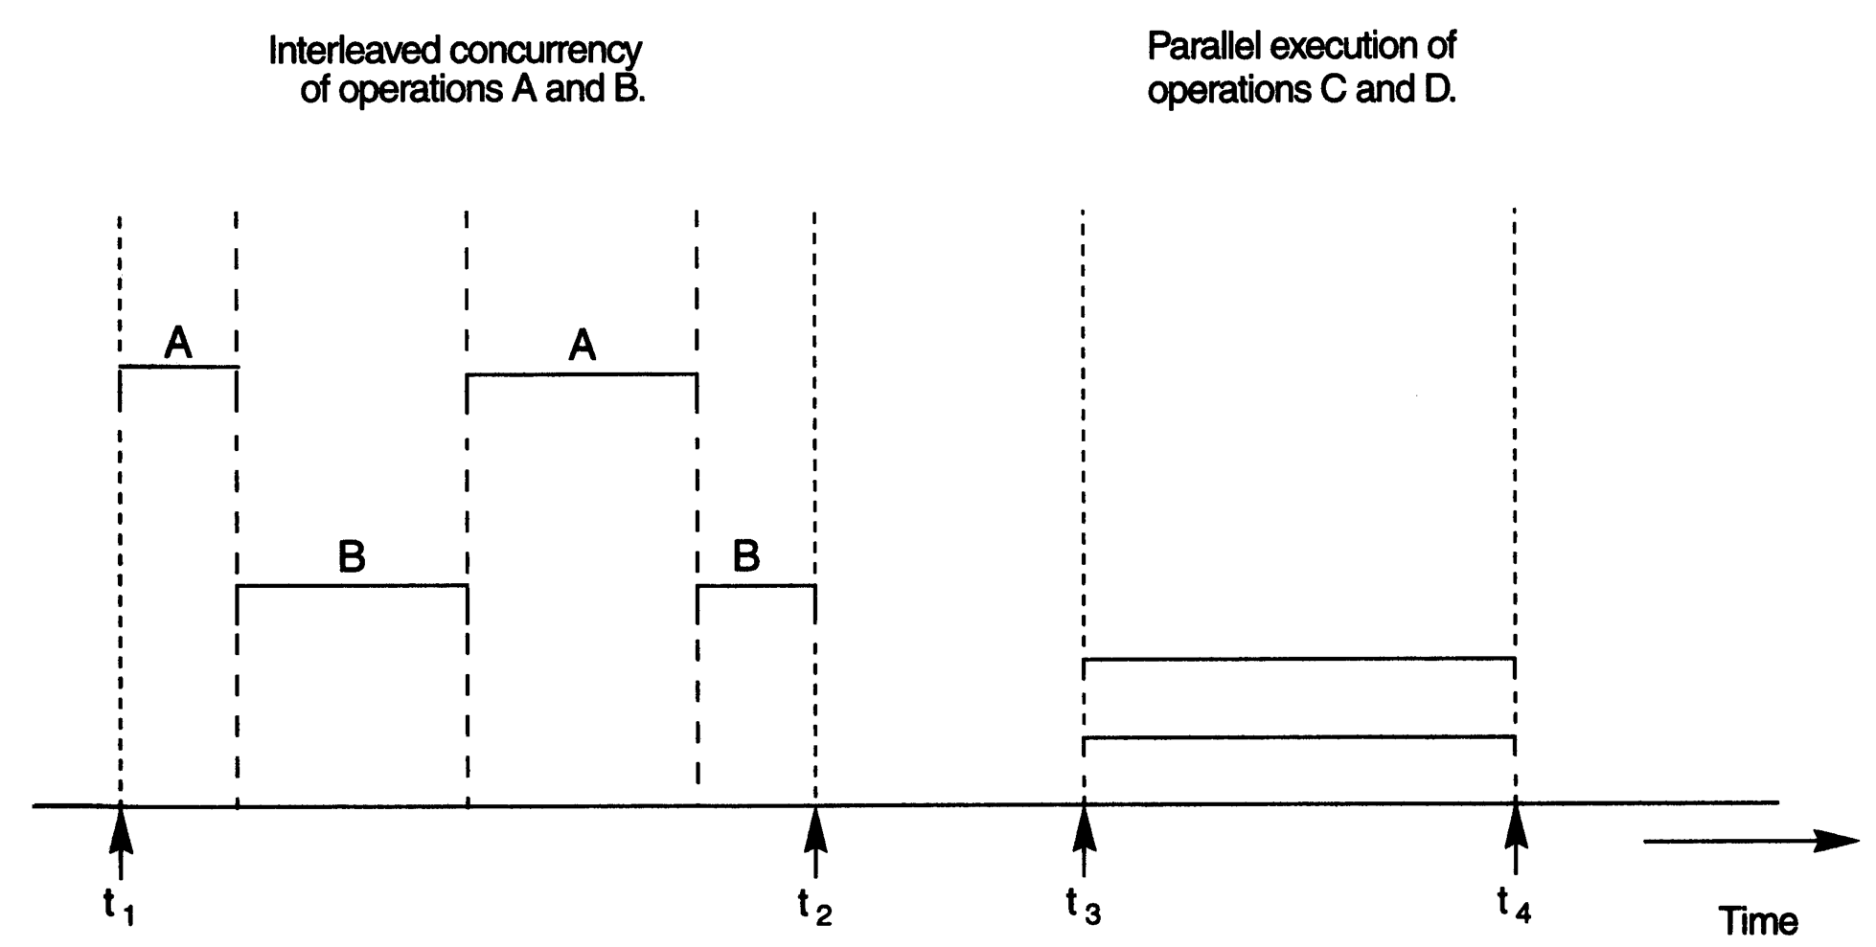
BUFFERING OF BLOCKS

Slide 56
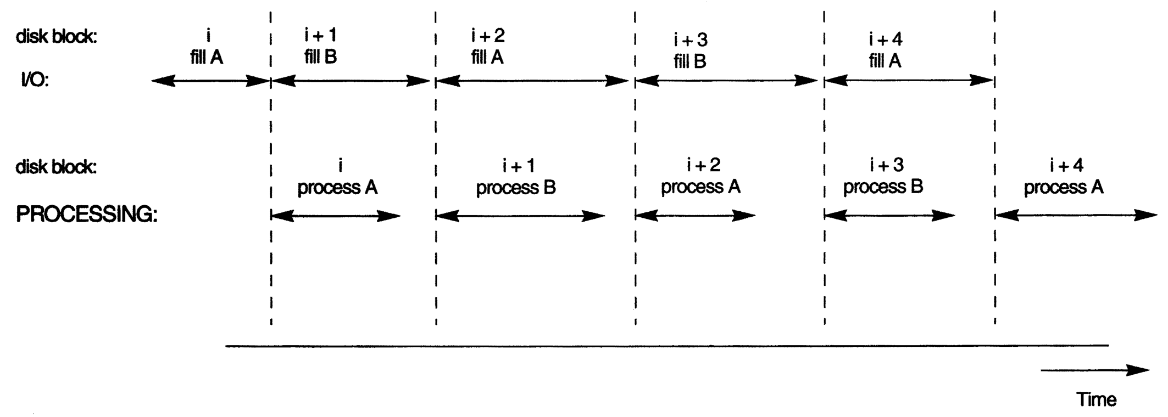
BUFFERING OF BLOCKS

Slide 57
PLACING FILE RECORDS ON DISK
Data is usually stored in the form of records, which are a collection of fields.
A record may represent an entity (tuple), and thus each field corresponds to an attribute.
A data type associated with each field, specifies the types of values a field can take.
A collection of field names and their corresponding data types constructs a record type or record format definition.

Slide 58
PLACING FILE RECORDS ON DISK
A file is a sequence of records.
If every record in the file has the same size, the file is of type fixed-length records.
If different records in the file have different sizes, the file is of type variable-length records.
A file that contains records of different record types and hence of varying size is called a mixed file.
For variable length fields, we could use a special separator character (which does not appear in any field value) to terminate variable-length fields.

Slide 59
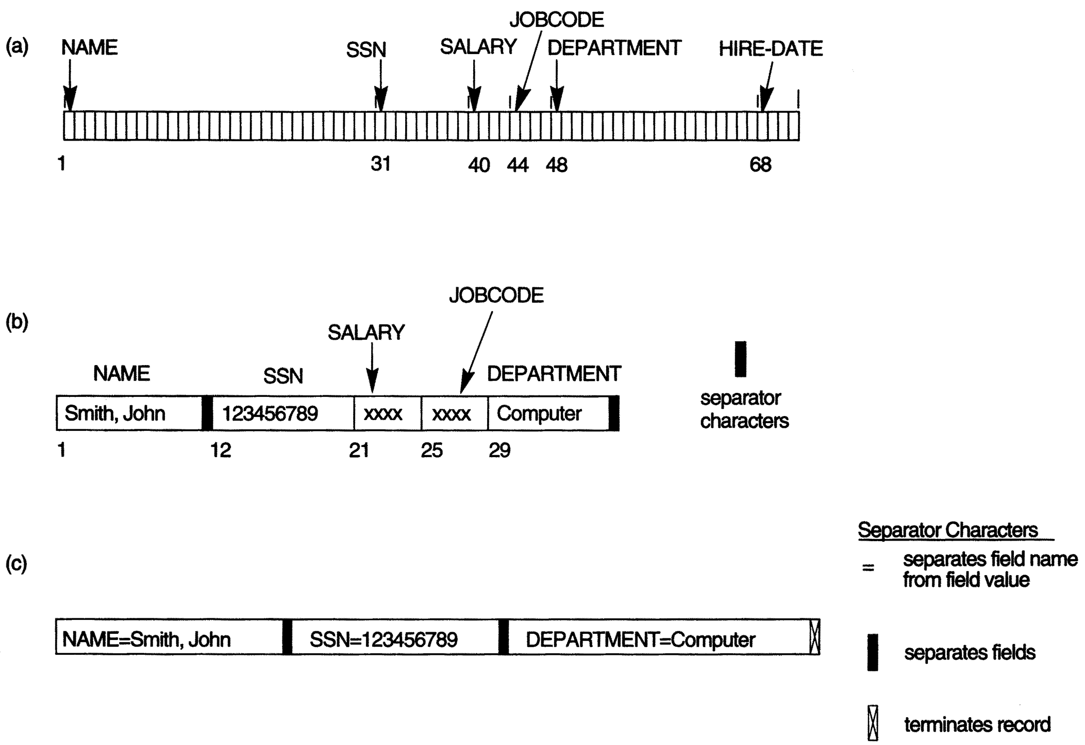
PLACING FILE RECORDS ON DISK
(a) A fixed-length record with six fields and size of 71 bytes
(b) A record with two variable-length fields and three fixed-length fields
(c) A variable-field record with three types of separator characters

Slide 60
PLACING FILE RECORDS ON DISK
A block is the unit of data transfer between disk and memory.
The blocking factor is determined by the number of records per block,
bfr = ⌊ B/R ⌋
If records are allowed to cross block boundaries, the file organization is called spanned.
If records are not allowed to cross block boundaries, the file organization is called unspanned.

Slide 61
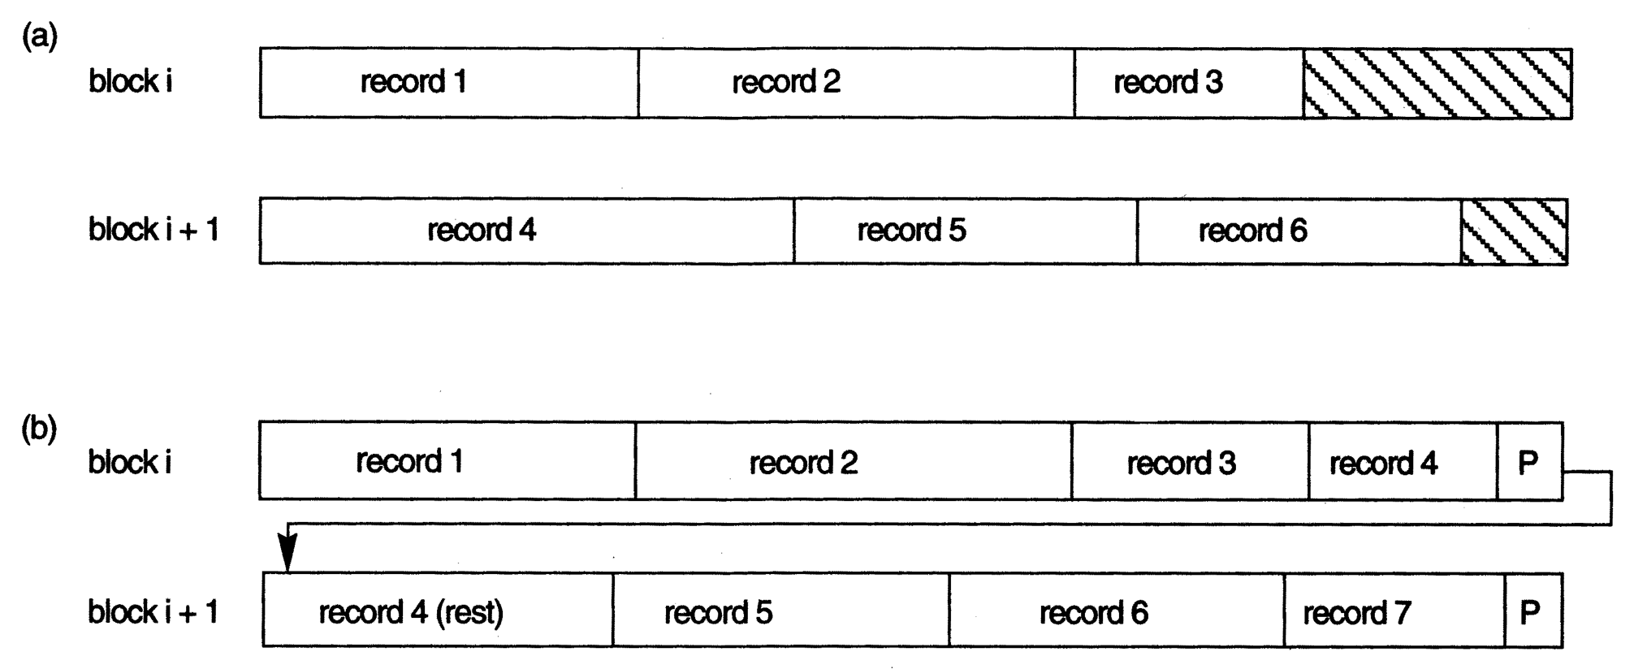
PLACING FILE RECORDS ON DISK
Types of record organization:
(a) Unspanned (b) Spanned

Slide 62
PLACING FILE RECORDS ON DISK
In contiguous allocation, the file blocks are allocated to consecutive disk blocks.
In linked allocation, each file block contains a pointer to the next file block.
In indexed allocation, one or more index blocks contain pointers to the actual file blocks.
A file header or file descriptor contains information about a file (e.g., the disk address, record format descriptions, etc.)

Slide 63
OPERATIONS ON FILES
Two main types of operations:
  Retrieval operations: do not change any data in the file
  Update operations: changes the file by insertion or deletion of records or by modification of field values.
Actual operations for locating and accessing file records implies the following high-level operations:
  Open
  Reset
  Find
  Read
  FindNext
  Update (insert, delete, modify)
  Close

Slide 64
OPERATIONS ON FILES
A file organization refers to the way records and blocks are placed on the storage device.
An access method, provides a group of operations that can be applied to a file.
A file is said to be static, if the update operations are rarely applied to it, otherwise it is dynamic.
A good file organization should perform as efficiently as possible the operation we expect to apply frequently to the file.

Slide 65
FILES OF UNORDERED RECORDS
Records are placed in the file in the order in which they are inserted. Such an organization is called a heap or pile file.
Insertion: is very efficient
Searching: requires a linear search (expensive)
Deleting: requires a search, then delete:
    Copy the block into a buffer, delete from buffer, and rewrite the block (leaves unused space in the disk block)
    Having an extra byte or bit (deletion marker).
  Both of these deletion techniques require reorganization.

Slide 66
FILES OF ORDERED RECORDS
Records of a file on disk are ordered based on the values of one of their fields.
Reading the records in order of the ordering field is extremely efficient.
Search: is very efficient (Binary search)
Insertion and deletion are expensive.
Ordering files are rarely used in database applications (unless using indexed-sequential files)

Slide 67
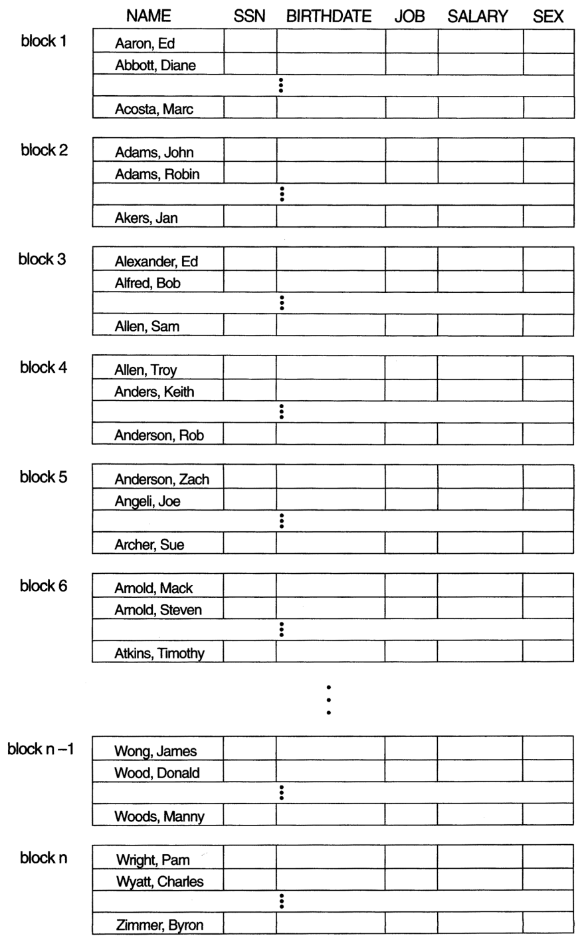
FILES OF ORDERED RECORDS
Some blocks
of an ordered
(sequential) file
of EMPLOYEE
records with
NAME as the
ordering key field.

Slide 68
HASHING TECHNIQUES
A hash function maps the hash field of a record into the address of the storage media in which the record is stored.
Hashing provides very fast access to records, where the search condition is an equality condition on the hash field.
For internal files, hashing is implemented as a hash table. The mapping that assigns each element of the data a cell of the hash table is called a hash function.

Slide 69
HASHING TECHNIQUES
Two records that yield the same hash value are said to collide.
A good hash function must be easy to compute and generate a low number of collisions.
The process of finding another position (for colliding data) is called collision resolution.
There are several methods for collision resolution, including open addressing, chaining, and multiple hashing.

Slide 70
HASHING TECHNIQUES
Open addressing: Proceeding from the occupied position specified by the hash function, check the subsequent positions in order until an unused position is found.
Chaining: Associate an overflow area (or a linked list) to any cell (hashing address) and then simply store the data in this medium.
Multiple hashing: Apply a second hash function if the first results in a collision. If another collision results, use open addressing, or apply a third hash function, and then use open addressing.

Slide 71
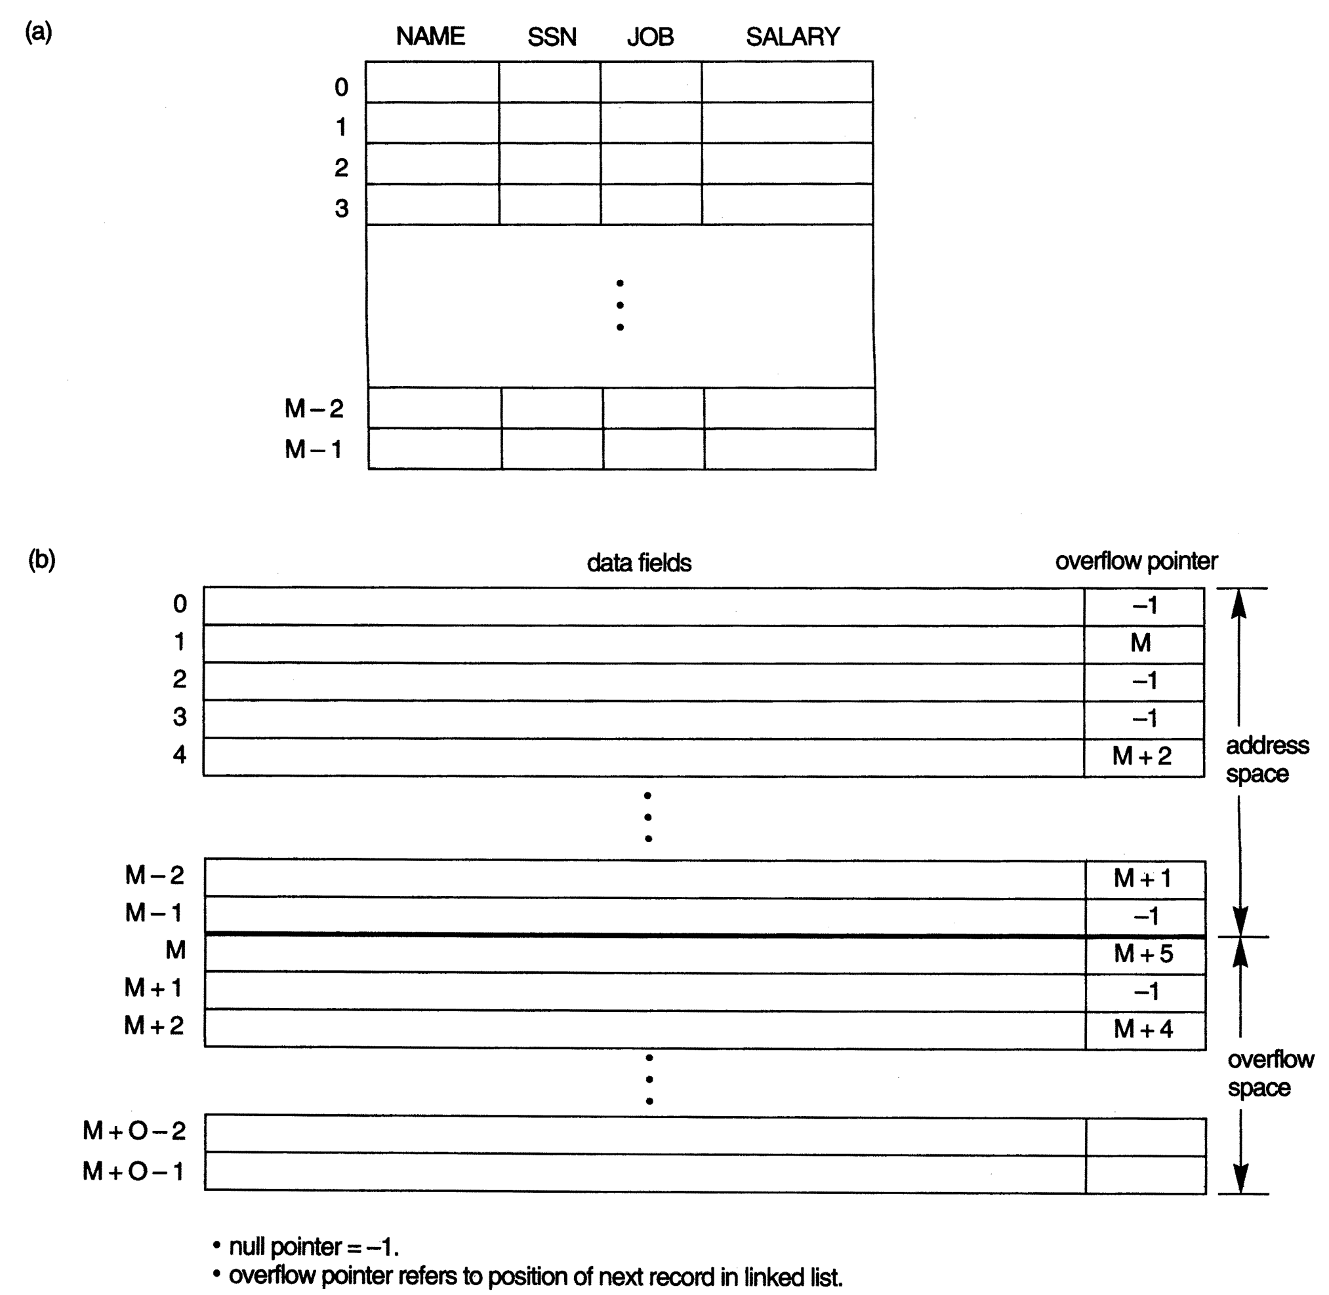
HASHING TECHNIQUES
Internal hashing
data structures.
Array of M
positions for use
in internal hashing.
Collision
resolution by
chaining records.

Slide 72
HASHING TECHNIQUES
Hashing for disk files is called external hashing.
The target address space in external hashing is made of buckets (which holds a disk block or a cluster of contiguous blocks).
The collision problem is less severe, because as many records as will fit in a bucket can hash to the same bucket without causing collision problem.
A table maintained in the file header converts the bucket number into the corresponding disk block address.

Slide 73
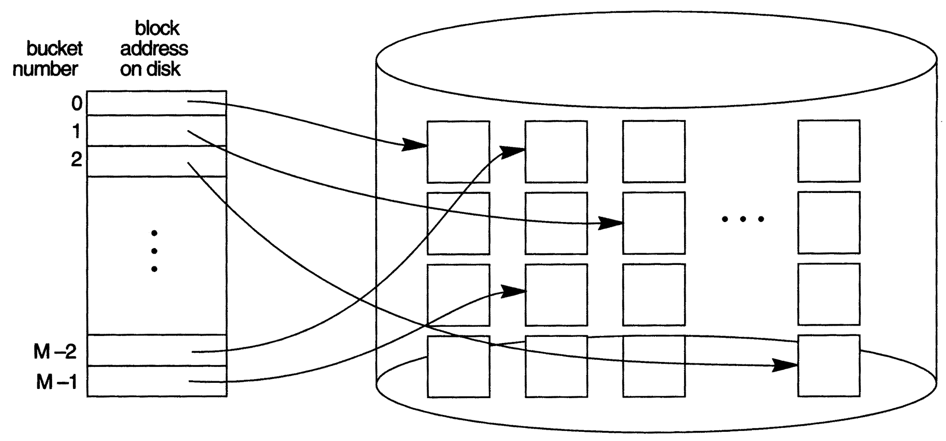
HASHING TECHNIQUES
Matching bucket numbers to disk block addresses.

Slide 74
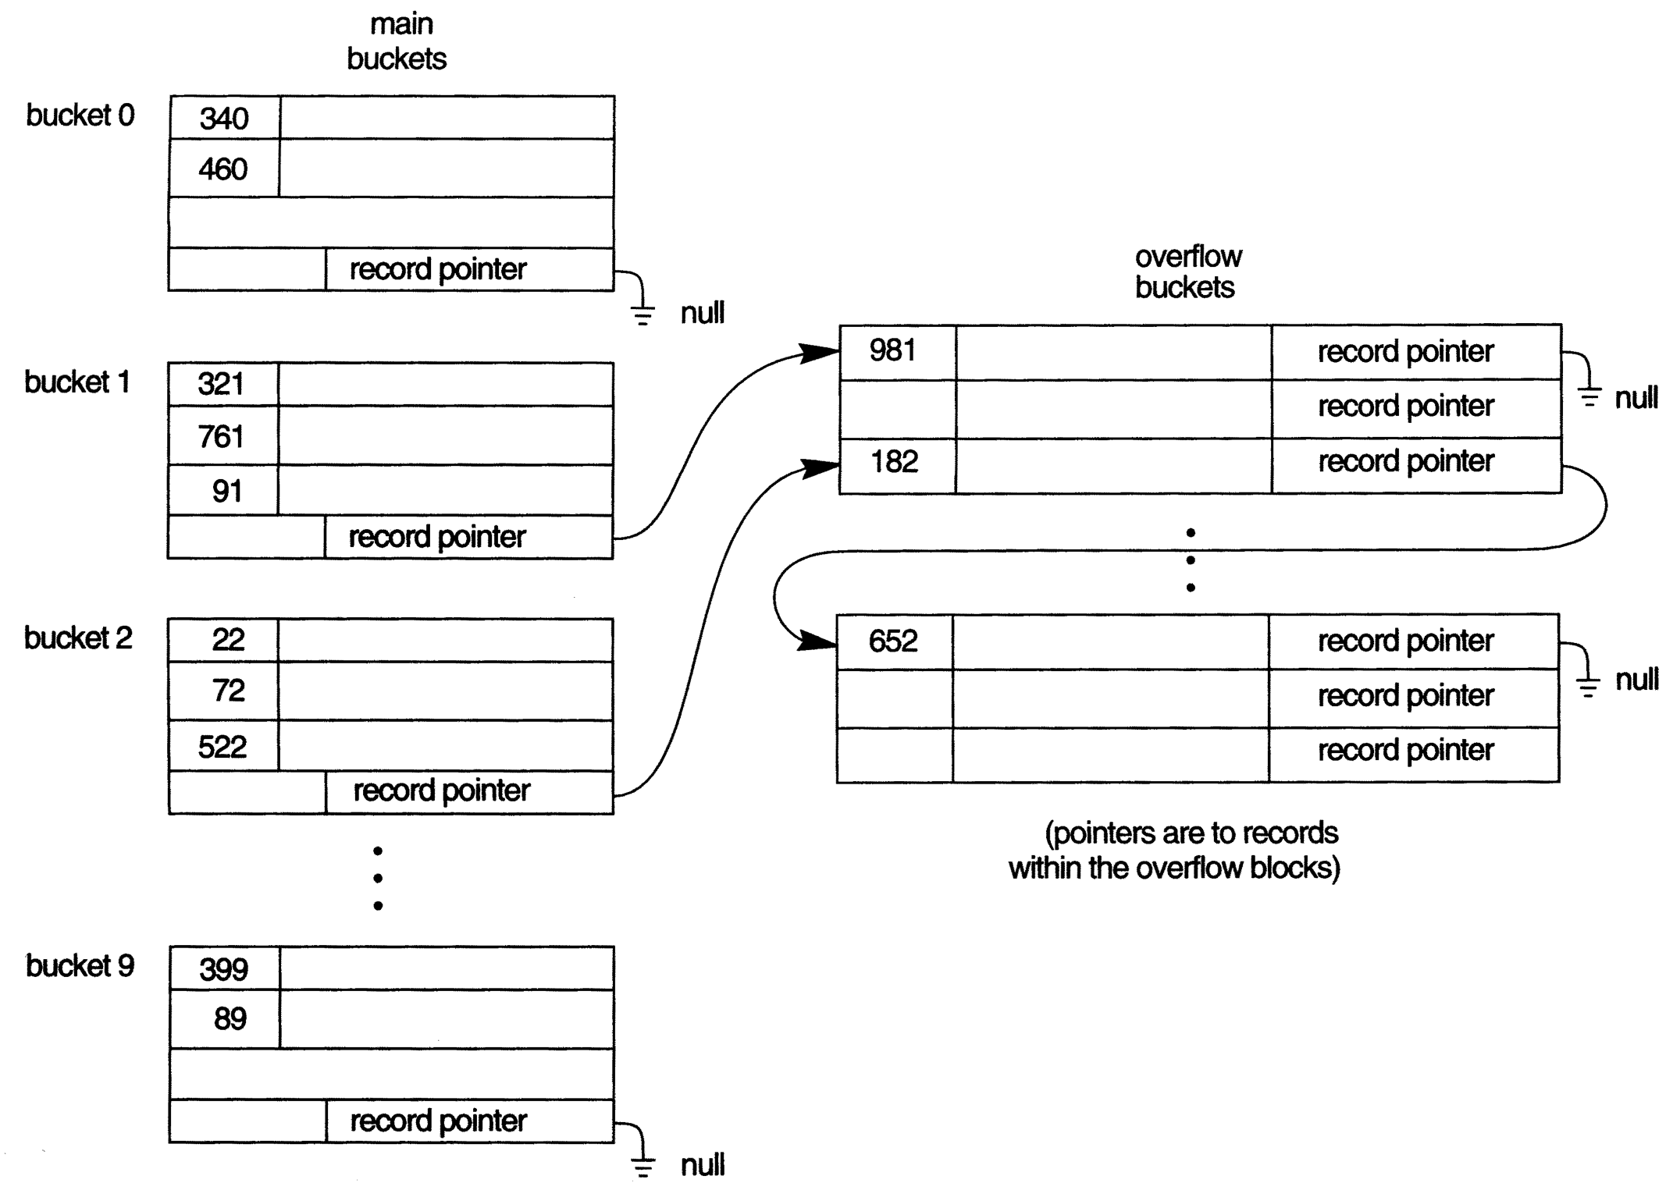
HASHING TECHNIQUES
Handling overflow for buckets by chaining.

Slide 75
HASHING TECHNIQUES
The hashing scheme is called static hashing if a fixed number of buckets is allocated.
A major drawback of static hashing is that the number of buckets must be chosen large enough that can handle large files. That is, it is difficult to expand or shrink the file dynamically.
Two solutions to the above problem are:
    Extendible hashing, and
    Linear hashing

Slide 76
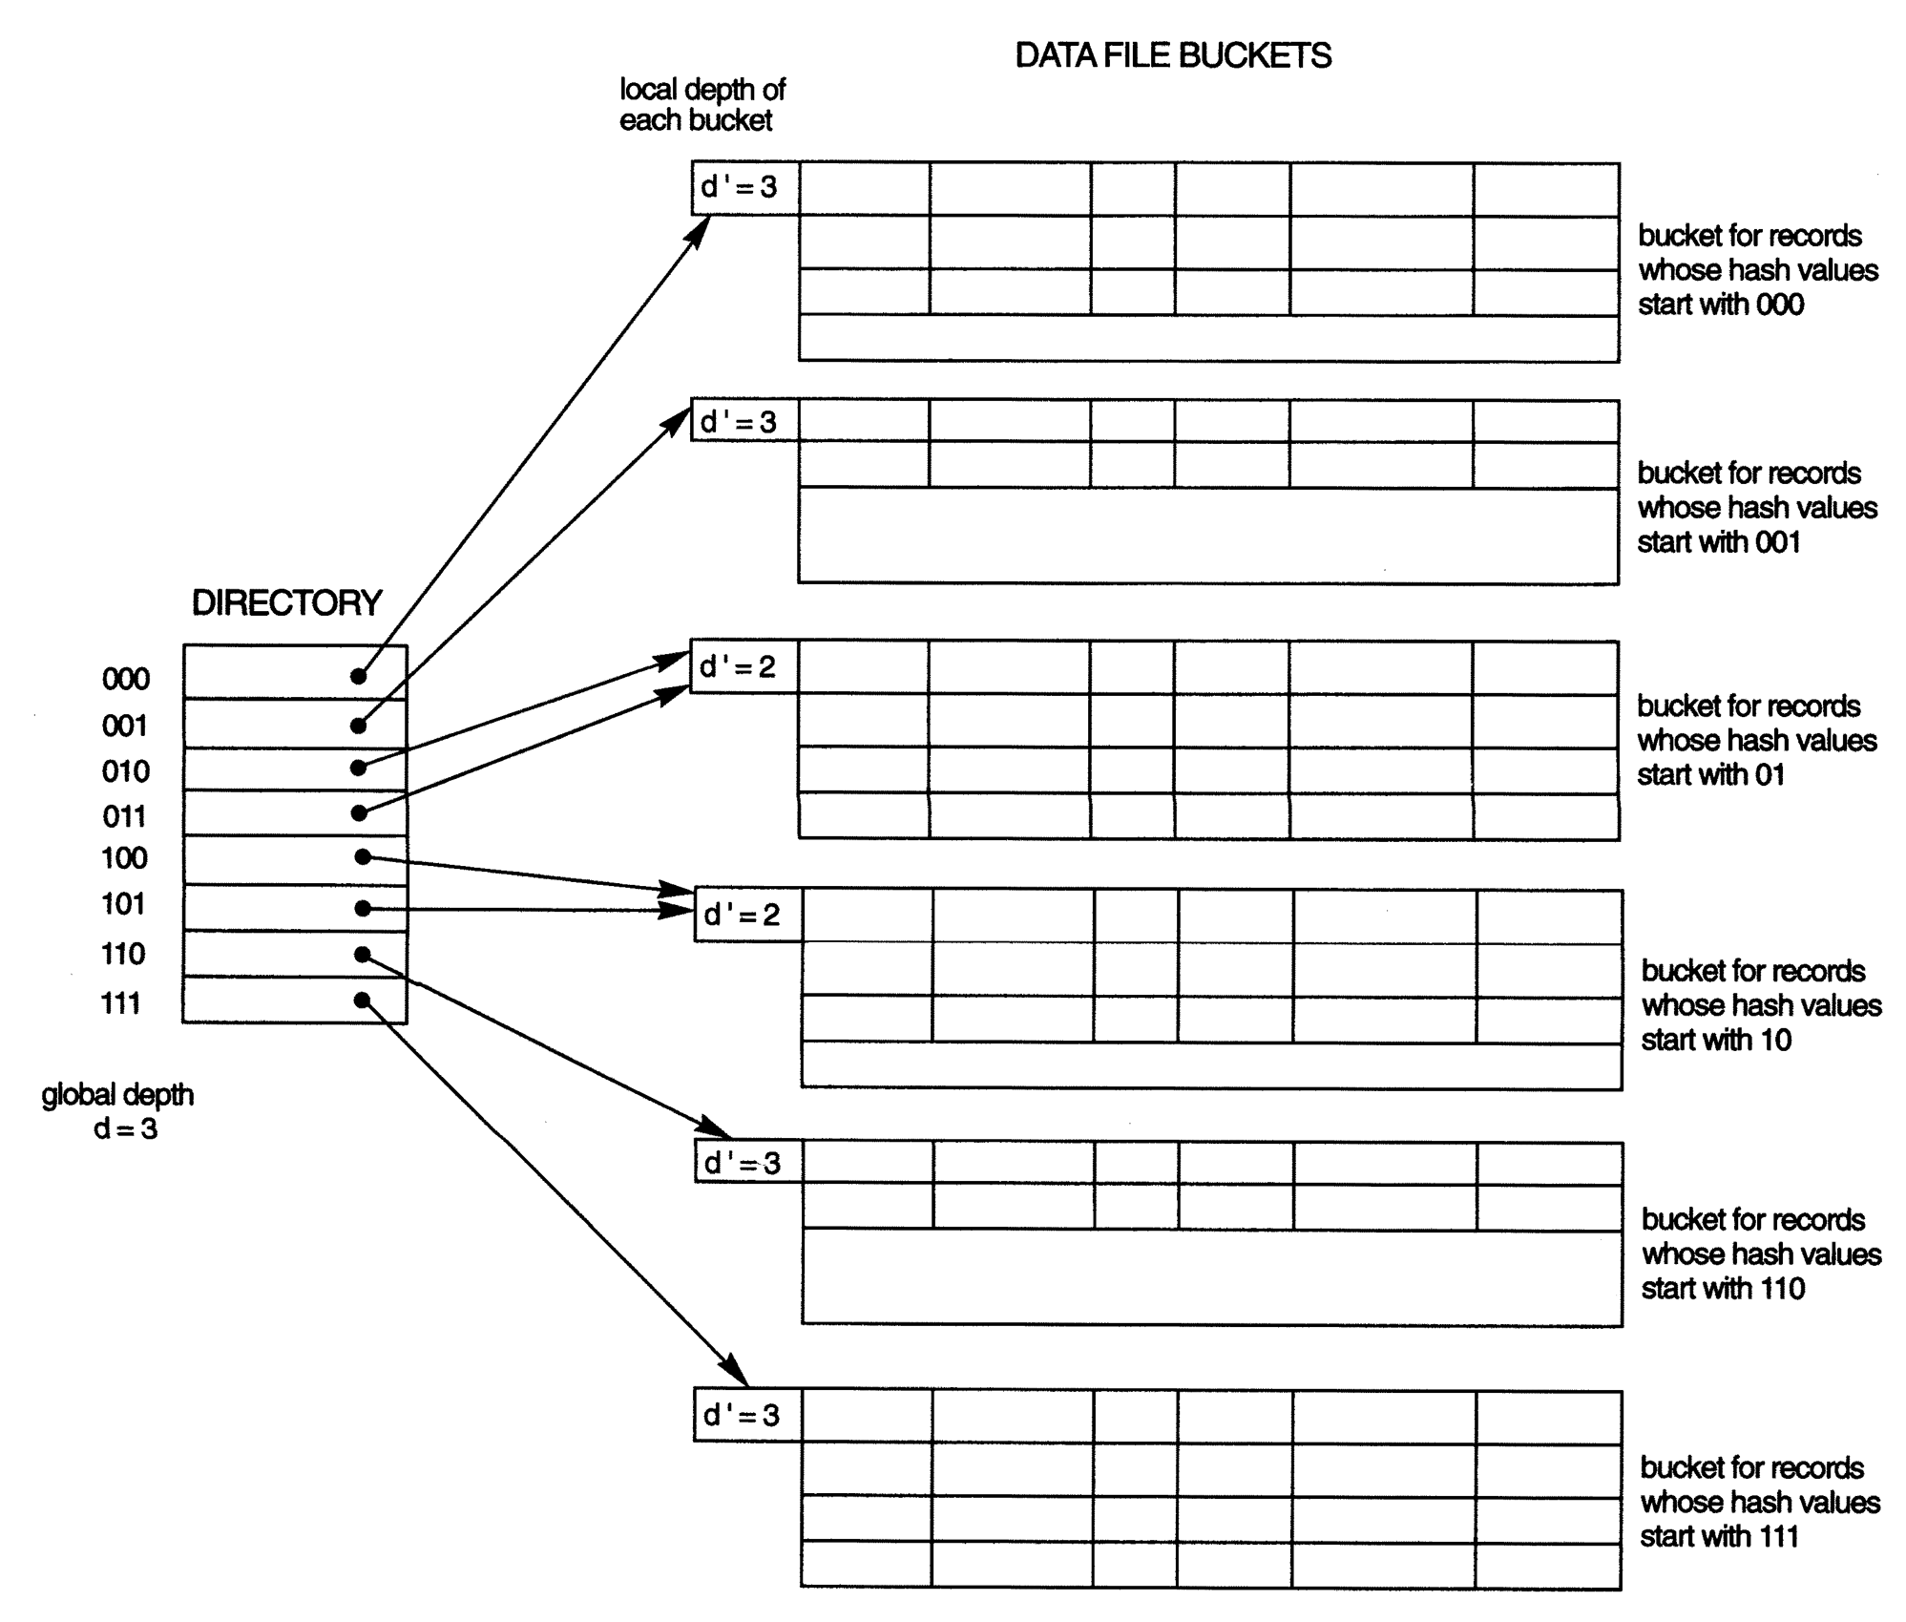
STRUCTURE OF THE EXTENDIBLE HASHING SCHEME

Slide 77
PARALLELIZING DISK ACCESS USING RAID TECHNOLOGY
A major advance in disk technology is represented by the development of Redundant Arrays of Inexpensive/Independent Disks (RAID).
Improving Performance with RAID: a concept called data striping is used. It distributes data transparently over multiple disks to make them appear as a single disk.
Improving Reliability with RAID: A concept called mirroring or shadowing is used. Data is written redundantly to two identical physical disks that are treated as one logical disk.

Slide 78
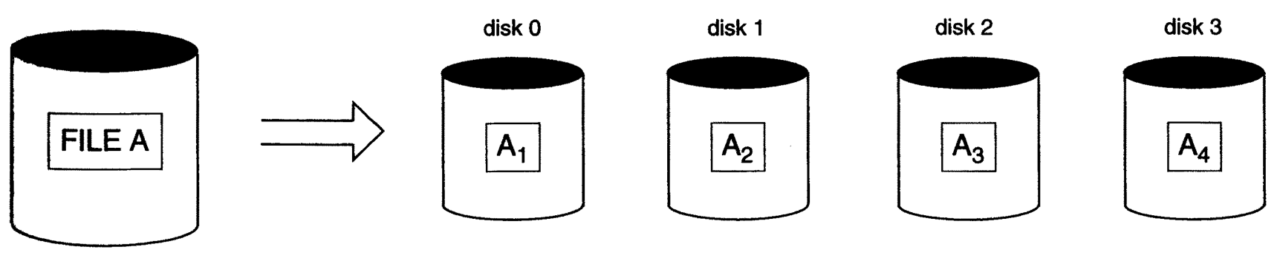
PARALLELIZING DISK ACCESS USING RAID TECHNOLOGY
Data striping. File A is striped across four disks.

Slide 79

SLIDE 10
THANK YOU

